Slide 1
CAREER ASIPIRATION ON GENERATION Z
KULTUREHIRE
Rakesh Kumar M

Slide 2
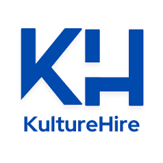
1.INTRODUCTION
Who is Generation Z?
Born between 1997 and 2012, Generation Z is now stepping into the workforce. They differ from previous generations in their preferences, influenced by technology, social media, and the fast-evolving job market.
Key Characteristics
Gen Z is often described as digital natives, valuing purpose over profit, and placing a premium on diversity, inclusivity, and work-life balance. Unlike previous generations, they seek workplaces where they can grow personally and professionally, while contributing to societal progress.
Why It Matters
Companies need to adapt their hiring and retention strategies to attract Gen Z talent, as their aspirations and expectations are fundamentally different from those of Millennials and Generation X.

Slide 3

2.KEY FINDINGS
Insights into the Motivations and Preferences of Gen Z in the Workplace
1. Influencing Factors
Generation Z relies heavily on external influences such as social media, influencers, and peers when making career decisions. This generation seeks guidance not just from traditional mentors but also from online communities and public figures.
2. Higher Education and Career
A large portion of respondents indicated a desire to pursue higher education while working, indicating that continued learning is important. Many see education as a tool for both personal and professional development, preferring jobs that offer education benefits and skills training.
3. Company Culture is Critical
70% or more of Gen Z respondents ranked company culture as one of the top factors influencing their job selection. They seek inclusive, transparent, and supportive work environments, which goes beyond just compensation and benefits.
.

Slide 4
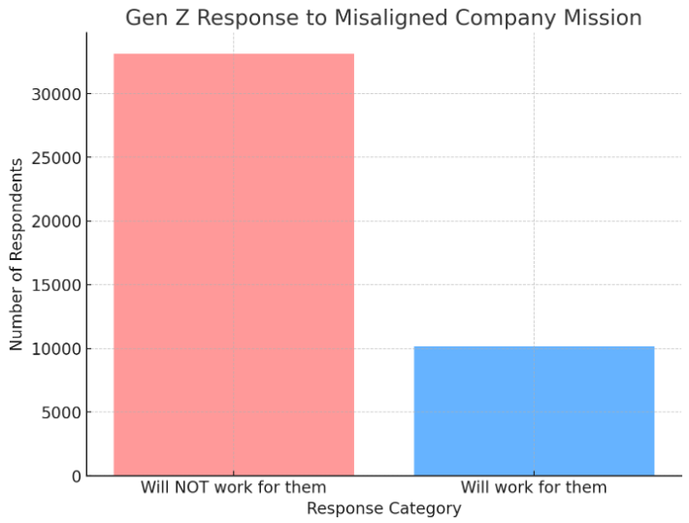
4. Importance of Company Mission
Over 80% of Gen Z workers stated that they would not consider working for a company if its mission was unclear or misaligned with public values. This illustrates the growing emphasis they place on purpose-driven organizations.

Slide 5
3.KEY WOW INSIGHTS
The Power of Company Mission Alignment
A Strong Value Shift: A surprising and significant finding is that 85% of Generation Z respondents would refuse to work for companies whose mission is misaligned with their actions or products. For Gen Z, it is not enough for a company to have a mission statement; it must live by those values.
Corporate Authenticity Matters: In contrast to previous generations, who might prioritize job security or salary, Generation Z holds corporations to higher standards of ethics and transparency. This focus on authenticity reflects their growing influence in shaping more socially responsible corporate practices
Impact on Recruitment and Retention: Companies that do not align their actions with their stated missions may struggle to attract and retain Gen Z talent. This generation is willing to walk away from a job if the organization doesn't meet its ethical expectations, signaling a major shift in workforce dynamics.

Slide 6
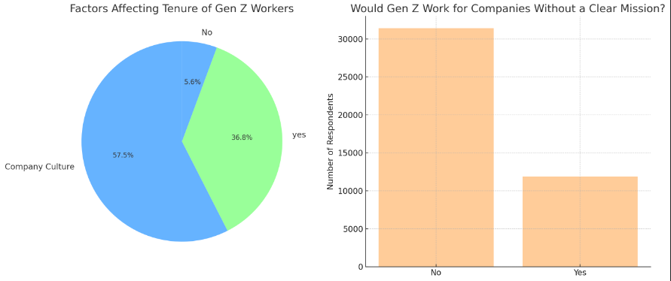
KEY WOW INSIGHTS (DATA VISUALIZATION)

Slide 7
4.RECOMMENDATIONS
Best Practices for Attracting and Retaining Generation Z Talent
1.Missions and Value Alignment: Gen Z cares deeply about working for a company that aligns with their values. Companies should regularly communicate how their mission is integrated into business decisions, products, and operations. Gen Z demands transparency and authenticity.
2.Support Lifelong Learning: Offer educational opportunities and encourage continued skill development. Whether through tuition reimbursement, online courses, or in-house training programs, companies that foster learning and growth will be more attractive to Gen Z candidates.
3. Cultivate a Positive and Inclusive Culture:Focus on creating a work environment that is inclusive, diverse, and empathetic. Ensure that your company culture encourages open communication, mental well-being, and a strong sense of belonging. Gen Z looks for places where they feel accepted and valued.
4. Use Social Media to Engage Talent: Engage with Gen Z on platforms they frequent, such as Instagram, TikTok, and LinkedIn. Utilize these platforms to showcase the company’s culture, mission, and employee success stories. Gen Z expects companies to have a modern digital presence, and they often make career decisions based on what they see online.

Slide 8
5.TAKEAWAYS
Takeaways on Gen Z’s Workplace Expectations
1.Purpose –Drive Generations: Generation Z is purpose-driven, seeking out employers who are transparent, ethical, and aligned with social causes. The company’s mission must reflect genuine values, not just be a marketing tool.
2.Learning and Development : Genz Z is focused on self-improvement, and they expect employers to provide continuous learning opportunities. They are attracted to companies that invest in their personal and professional growth.
3.Work-Life Balance and Flexibility: Flexibility, work-life balance, and mental health support are non-negotiable. Employers who can offer flexible working hours, remote work options, and mental health support will be more successful in retaining Gen Z employees.
4.Transparency and Authenticity: The emphasis on transparency and authenticity is critical. Gen Z wants to see companies live by their values. For businesses, this means that actions must consistently reflect their mission and promises to the public.

Slide 9
CONCLUSION
The career aspirations of Generation Z reflect a profound shift in how young professionals approach their careers and work environments. Unlike previous generations, Gen Z is driven by a desire for purpose and authenticity in the workplace, placing significant importance on a company’s mission and how it aligns with its actions. This generation wants to work for organizations that not only talk about social responsibility and inclusivity but actively demonstrate these values through their business practices. Gen Z’s reluctance to work for companies with unclear or misaligned missions underscores their growing demand for corporate integrity and transparency. As this generation enters the workforce, companies that align their actions with their stated values, offer flexible work environments, and invest in the personal and professional growth of their employees will find themselves better positioned to attract and retain top talent from Generation Z. In conclusion, the future of work is evolving, and businesses must take proactive steps to meet the expectations of Generation Z, which are centred around purpose, authenticity, and growth.

